Slide 1
Connecting the Brain
CS 375 Group Project
Ben Fox and Matt Kubisa

Slide 2
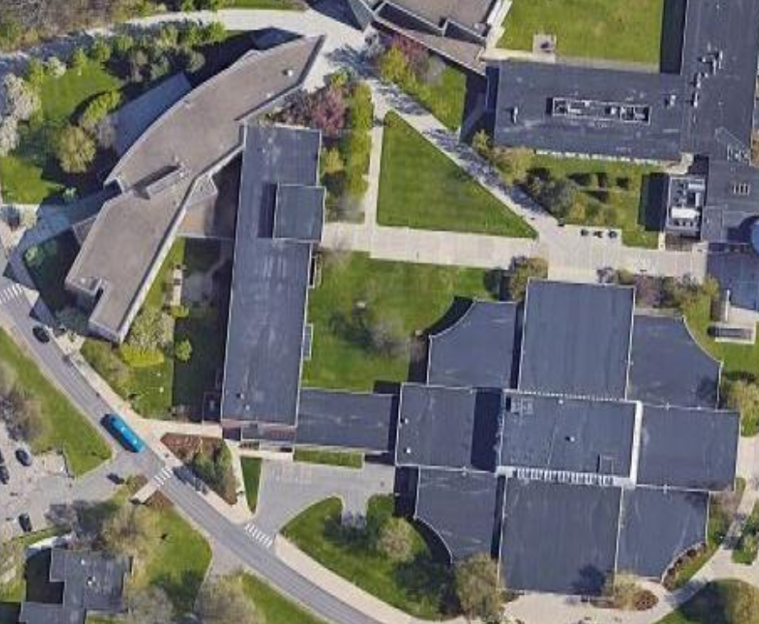
Motivation
Some buildings on Binghamton’s campus are already connected
Avoiding poor weather
Safer travel at night
However, many buildings still require going outside to access, no matter where you are
What if more buildings on the main campus were connected on the inside?
Academic Building A, the Classroom Wing, and the Lecture Hall (pictured) are physically connected to each other.
Source: https://www.google.com/maps/@42.0883165,-75.9714653,211m/data=!3m1!1e3

Slide 3
Proposal
Construct tunnels to connect all buildings inside the main campus
To reduce complexity, we’ve limited ourselves to only buildings within “The Brain” (no residence halls, athletic center, etc)
Use a minimum spanning tree to find the most efficient way of having all buildings connected
Multiple pathways to each building is expensive and time consuming.
MST provides adequate safety and shelter from the elements

Slide 4
Considerations
Some buildings are already connected
Combine already connected buildings into single nodes
Furthermore, a few of these “clusters” are still connected
Ideally, construction should be as inexpensive as possible and in the shortest amount of time
Keep the already built tunnels/connections to reduce price of new pathways
Factors in price and time of construction for a given tunnel:
Tunnel’s length: minimize
More tunnel → more time to build and more money in raw materials
Digging through existing infrastructure: minimize
Infrastructure → harder to get through than soil → more time to build and more money for safety personnel

Slide 5
Approach
Manually build a complete graph of the buildings on campus
Nodes represent buildings (or clusters of connected buildings)
Edges represent tunnels; edge weight = tunnel distance + penalty for existing infrastructure/ground type
Every building starts connected to every other building
Find minimum spanning tree of the graph using both Prim’s and Kruskal’s algorithm
Both algorithms should find the same result – each one “checks” the other
Using two algorithms raises confidence that the solution found is the most optimal
Eliminates redundant or too expensive connections
Return output of the two algorithms

Slide 6
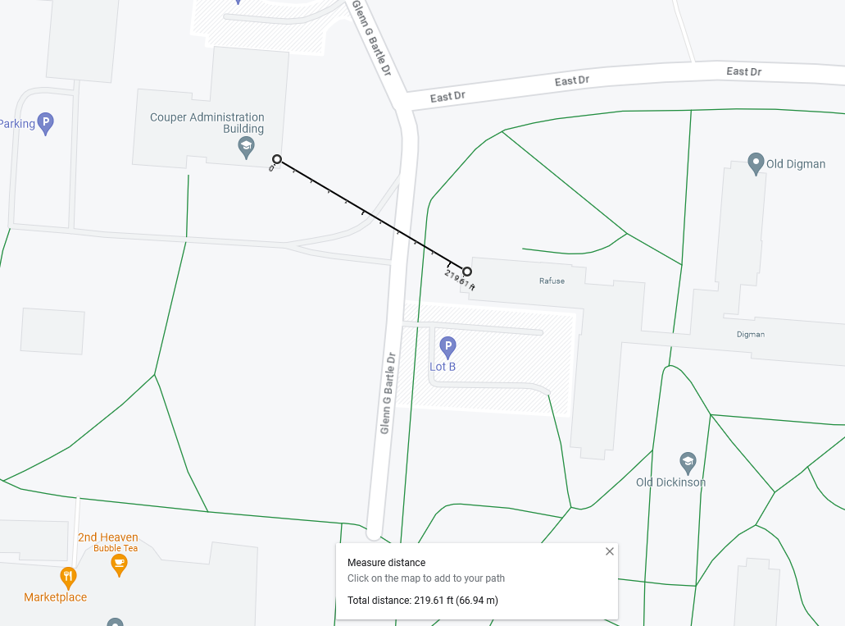
Graph Construction
Google Maps “measure distance” feature was used to find distances between pairs of buildings (pictured)
Consideration was made to minimize distances by measuring between the two closest walls
Source: https://www.google.com/maps/@42.0891062,-75.9658295,18.83z
Notes:
Matt

Slide 7
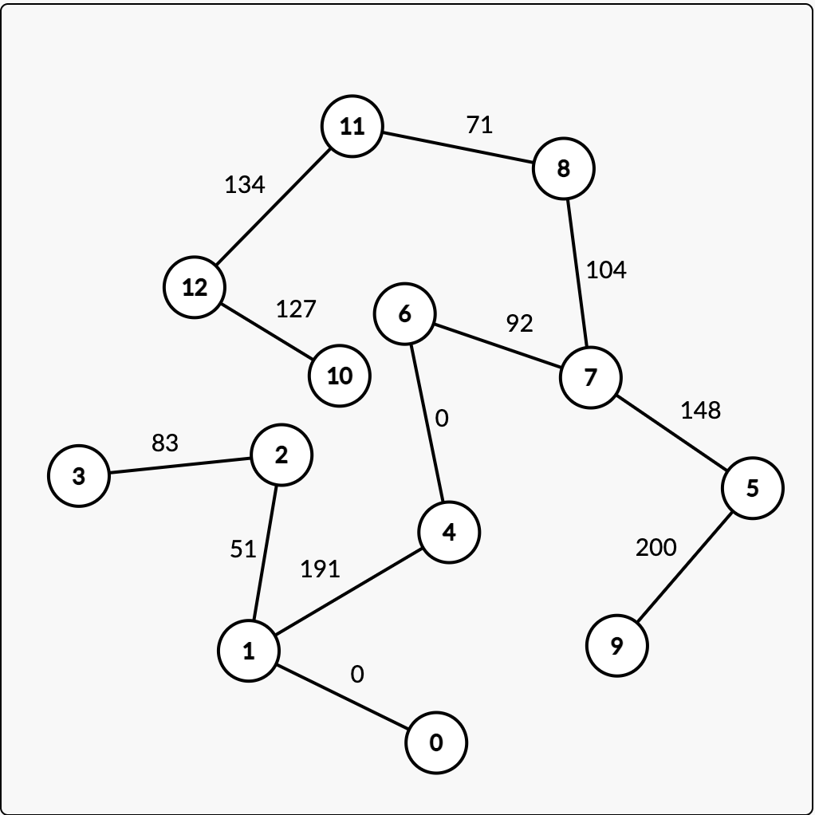
Graph Construction (cont.)
Kruskal result
Accounting for previously stated factors:
Digging through existing infrastructure: add coefficient to weight considered to account for increased difficulty
Existing connections: Mark the edge as “already exists” and ensure it’s included in the final tree
No need to destroy/abandon existing connections

